Slide 1

Presented By: Harshit Badaya Lekhram Dhruw
WIRELESS DIGITAL NOTICE BOARD

Slide 2
Introduction
In today’s world people desire wireless connection because they can intermingle with people easily and it require a smaller amount of time.
The main reason behind this project is to develop a wireless digital notice board that displays message sent from the approved user.
To design a simple, easy to install, user friendly system, which can collect and display notice in a particular order with respect to date and time.
It will help the user to easily keep the track of notice board each time he uses the system.

Slide 3
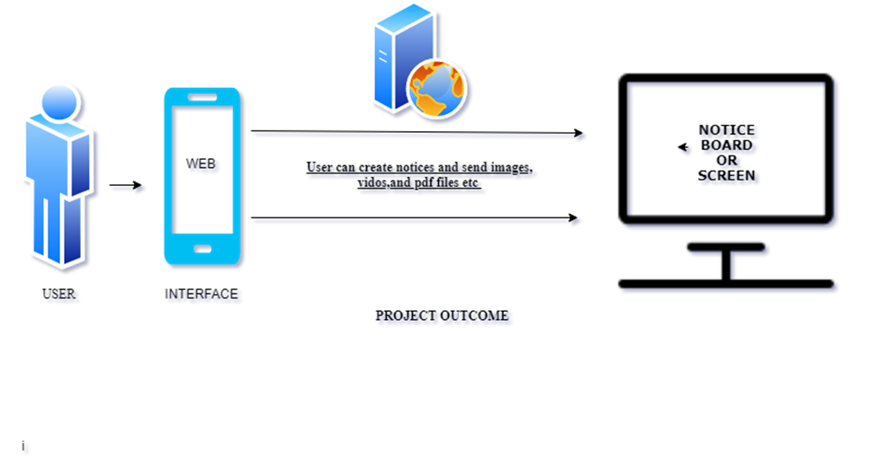

Slide 4
Problem Identification
The developments are increasing in the face of the situations that cause human life, notice boards are commonly used in variety of institutions which we come across in a daily basis.
In the present generation the advertisement notice boards are being managed manually.
This process is difficult to involve in order to put a notice on the notice board.
This waste a lot of things like paper printer ink, manpower and also brings the loss of time.

Slide 5
Our approach to the Problem
We have proposed a system through wireless transmit notices on a notice board or screen using IOT technology.
We have used Raspberry Pi board and network connection meanwhile local area connection of an particular organization connect both system and web interface with same network.
After that we can send notices, audio files ,video files, images etc. to the screen wirelessly notice board being used specially at offices and public places to display important news and notices.
This notice board is easy to use and effective everywhere and user Friendly.

Slide 6
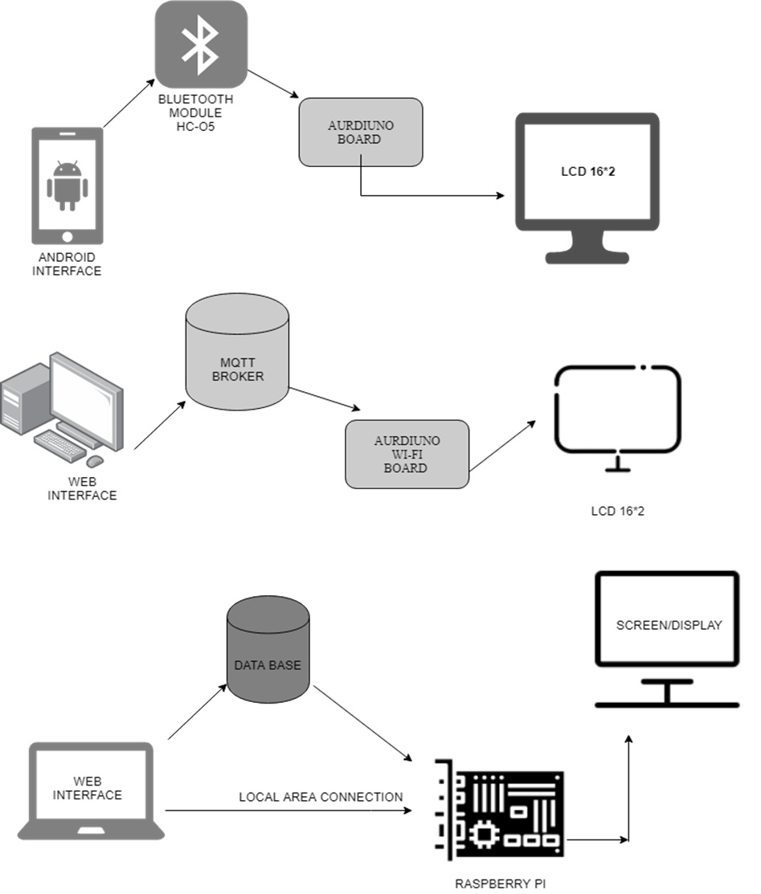

Slide 7
List of components used
Hardware Components:
Raspberry Pi 3 Board
LCD (16x2)
Bread Board
Connecting wires and jumper wires (Male & Female)
Power supply or Power Adapter & USB Cable
SD card
Software Components:
Win32disk imager
Raspbian OS
Python 3 and C
SD card formatter

Slide 8
Raspberry Pi Board
Raspberry Pi is a small single board computer.
By linking peripherals like Keyboard, mouse, display to the Raspberry Pi, it will act as a mini personal computer.
It is popularly used for real time Image/Video Dispensation, IoT based bids and Robotics bids.

Slide 9
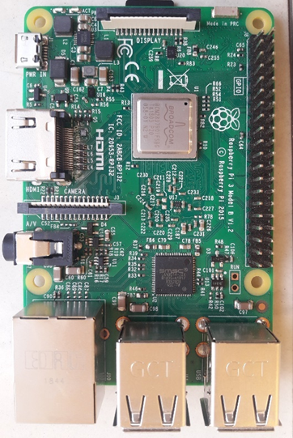
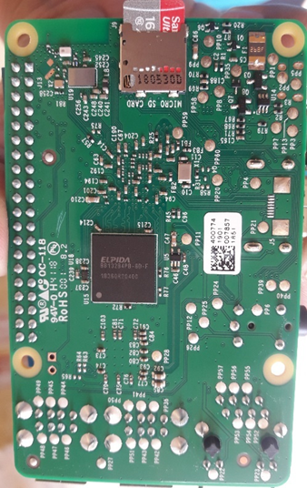
(FRONT) (BACK)

Slide 10
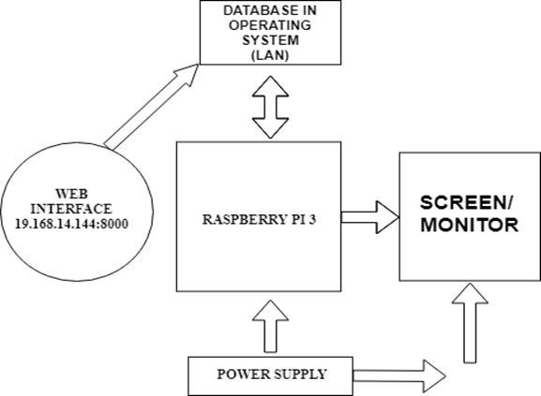
Block Diagram

Slide 11
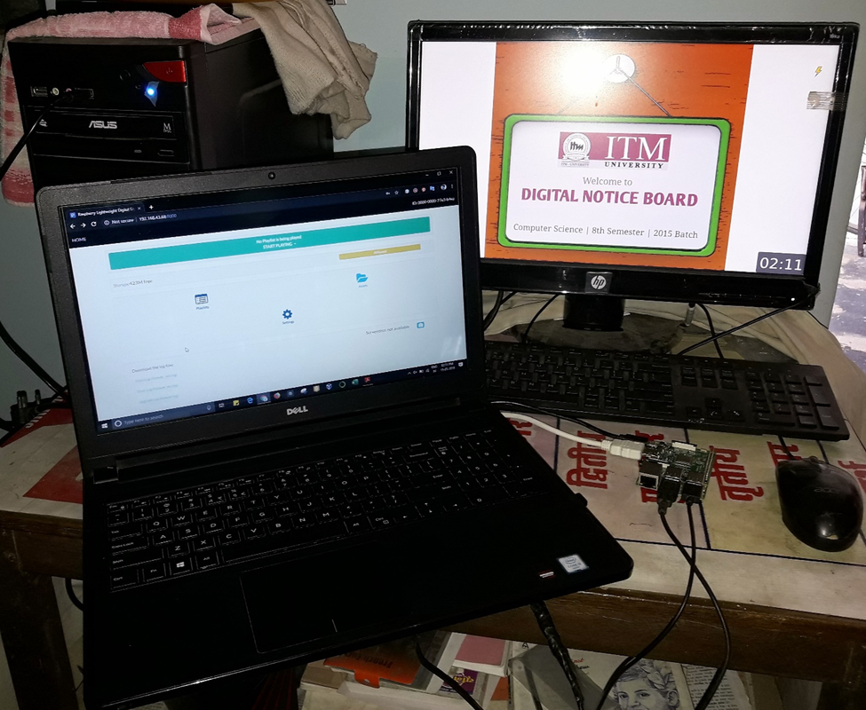
Project Image

Slide 12
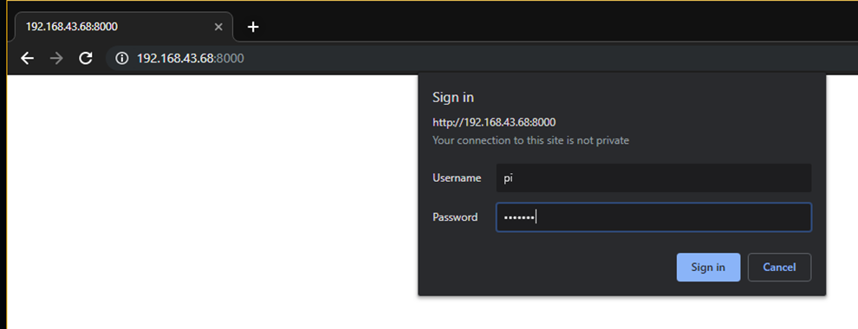
Results of Raspberry Pi based system
Login Page

Slide 13
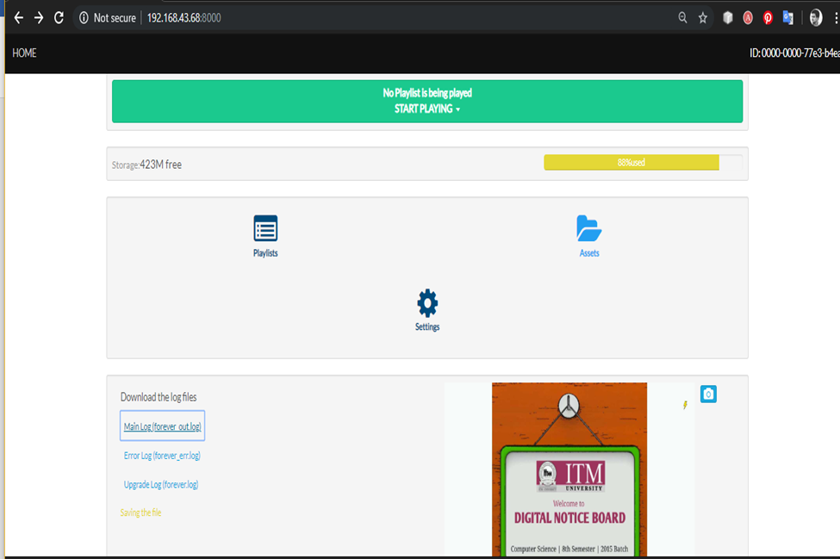
User Web Interface

Slide 14
Advantages
Low cost of manufacturing and no need of lengthy wires.
flexible and supple
Data can be sent wireless without taking much of time.
Communication is totally wireless.
low power consumption.
Data will not be lost in power failure.
Saves manual time and paper.
It can send notices in various ways like images, pdf, video etc.

Slide 15
Applications of our project
It can used in bank for creating ticket system for withdrawals line.
In advertisement industry it can be used.
In educational institutes, schools, colleges, tuitions, coaching it can be used for notices.
In stock exchange it can imply for displaying stock update on real time.
It can used in Cafe’s, restaurants and hotels.
In traffic control system.

Slide 16
Future Scope
This can be developed in online portal where it can need same network to connect.
We can create Android application for better convenience as user interface.
We can create multiple screen for same output and android app device for viewing the notices regularly.
It can be created for Pc’s, monitors mean it display on one screen, we can create a platform or service where it can send notices, content to many screens, devices etc. at same time.

Slide 17
References
http://www.ijsrd.com/articles/IJSRDV4I110551.pdf
http://ai2.appinventor.mit.edu/#4625328107028480
https://www.draw.io/
http://www.ijfrcsce.org/download/browse/Volume_4/April_18_Volume_4_Issue_4/1524280824_20-04-2018.pdf
https://circuitdigest.com/microcontroller-projects/wireless-notice-board-using-gsm-and-arduino
https://www.arduino.cc/en/Tutorial/HelloWorld
https://howtomechatronics.com/tutorials/arduino/lcd-tutorial/

Slide 18
Thank you
Any Queries?

